Slide 1
Lecture 4 Chapter2
Classification of casting Processes
Casting processes can be classified into following FOUR categories:
1. Conventional Molding Processes
Green Sand Molding
Dry Sand Molding
Flask less Molding
2. Chemical Sand Molding Processes
Shell Molding
Sodium Silicate Molding
No-Bake Molding
3. Permanent Mold Processes
Gravity Die casting
Low and High Pressure Die Casting
4. Special Casting Processes
Lost Wax
Ceramics Shell Molding
Evaporative Pattern Casting
Vacuum Sealed Molding
Centrifugal Casting

Slide 2
Conventional Molding Processes
1-a. Green Sand Molding
Green sand is the most diversified molding method used in metal casting operations. The process utilizes a mold made of compressed or compacted moist sand. The term "green" denotes the presence of moisture in the molding sand. The mold material consists of silica sand mixed with a suitable bonding agent (usually clay) and moisture.

Slide 3
Advantages
Most metals can be cast by this method.
Pattern costs and material costs are relatively low.
No Limitation with respect to size of casting and type of metal or alloy used
Disadvantages Surface Finish of the castings obtained by this process is not good and machining is often required to achieve the finished product.

Slide 4
Sand Mold Making Procedure
The procedure for making mold of a cast iron wheel
The first step in making mold is to place the pattern on the molding board.
The drag is placed on the board
Dry facing sand is sprinkled over the board and pattern to provide a non sticky layer.
Molding sand is then riddled in to cover the pattern with the fingers; then the drag is completely filled.

Slide 5
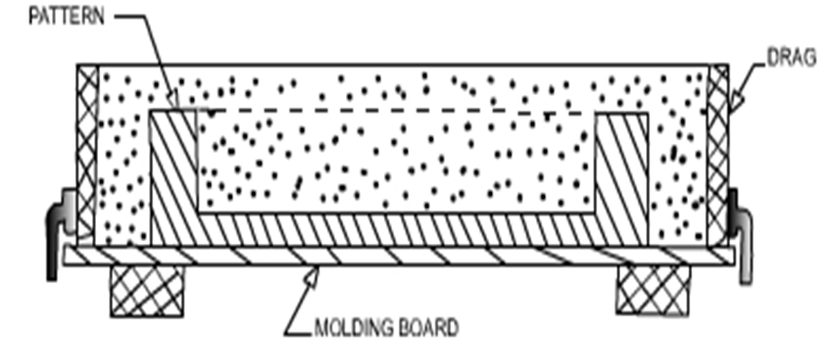
The sand is then firmly packed in the drag by means of hand rammers. The ramming must be proper i.e. it must neither be too hard or soft.
After the ramming is over, the excess sand is leveled off with a straight bar known as a strike rod.
With the help of vent rod, vent holes are made in the drag to the full depth of the flask as well as to the pattern to facilitate the removal of gases during pouring and solidification.
The finished drag flask is now rolled over to the bottom board exposing the pattern.

Slide 6
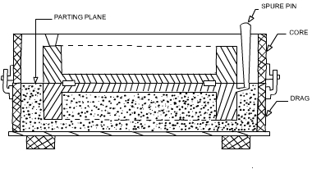
Cope half of the pattern is then placed over the drag pattern with the help of locating pins. The cope flask on the drag is located aligning again with the help of pins
The dry parting sand is sprinkled all over the drag and on the pattern.
A sprue pin for making the sprue passage is located at a small distance from the pattern. Also, riser pin, if required, is placed at an appropriate place.
The operation of filling, ramming and venting of the cope proceed in the same manner as performed in the drag.

Slide 7
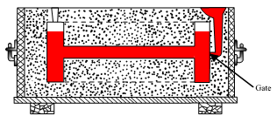
The sprue and riser pins are removed first and a pouring basin is scooped out at the top to pour the liquid metal.
Then pattern from the cope and drag is removed and facing sand in the form of paste is applied all over the mold cavity and runners which would give the finished casting a good surface finish.
The mold is now assembled. The mold now is ready for pouring

Slide 8
1-b. Dry Sand Molding
When it is desired that the gas forming materials are lowered in the molds, air-dried molds are sometimes preferred to green sand molds. Two types of drying of molds are often required.
Skin drying
Complete mold drying.
In skin drying a firm mold face is produced. Shakeout of the mold is almost as good as that obtained with green sand molding. The most common method of drying the refractory mold coating uses hot air, gas or oil flame. Skin drying of the mold can be accomplished with the aid of torches, directed at the mold surface.

